Slide 1
Factors That Drive Home Prices
Shadya Cisneros

Slide 2
Introduction
Investors play a crucial role in mortgage-backed securities by providing funds to home buyers. The effectiveness of this process relies heavily on the bank's competence in selecting sound investments. Gaining insights into the variables that affect home prices allows for more informed allocation of funds into mortgage-backed securities. This, in turn, can lead to optimized returns and more intelligent investment decisions in the real estate market.
In this presentation, I will investigate the impact of various factors on home prices. To achieve this, I will delve into the following research questions:
1) Is the number of fireplaces a significant predictor of home prices, and does it have a statistically significant impact on the variation in home prices?
2) Does the overall quality of a home have a statistically significant impact on its price, and is there a meaningful difference in home prices based on variations in overall quality?
3) Does the neighborhood in which a home is located have a statistically significant impact on its price, and is there evidence of price variations based on different neighborhoods?
4) Is the number of garage cars a statistically significant predictor of home prices, and does it have a meaningful impact on variations in home prices?

Slide 3
Hypotheses
The Hypotheses I tested in this project are as follows:
1) There is no significant difference in home price based on Fireplaces
2) There is no significant difference in home price based on Overall Quality
3). There is no significant difference in home price based on Neighborhood
4) There is no significant difference in home price based on Garage Cars

Slide 4
Data Set
The data set analyzed was a sample of 1460 houses in Ames, Iowa that were sold between 2006-2010.
The data includes 82 columns. There is an approx. even distribution of both categorical and continuous data.
The average Sales Price in this data set is: $180,921
This data set comes from Kaggle: https://www.kaggle.com/competitions/house-prices-advanced-regression-techniques/data

Slide 5
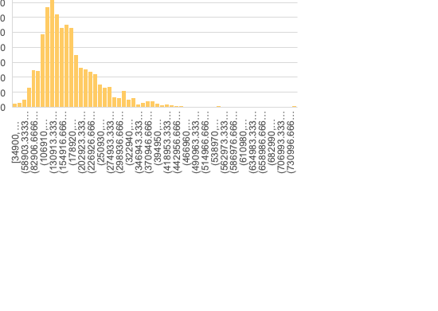
Data Set Stats
Sales Price
Mean | 180921.1959
Standard Error | 2079.105324
Median | 163000
Mode | 140000
Standard Deviation | 79442.50288
Minimum | 34900
Maximum | 755000

Slide 6
Methods
I conducted this project in Excel, employing pivot tables and the Data Analysis ToolPak to process and analyze the data.
I generated visuals to investigate patterns within the data and assess how the variables influenced home prices.
I conducted t-tests on variables that appeared to have the most significant impact on home prices, testing at a confidence level of 95%. I then analyzed the results to either support or reject my hypothesis.

Slide 7
RESULTS

Slide 8
Fireplaces
Hypothesis: There is no significant difference in home price based on Fireplaces
Reject Null Hypothesis
My findings confirmed the alternative hypothesis, indicating that the presence of fireplaces has an impact on average sales prices.
Tested: Variables 1 vs. 0
The t-statistic is very large, the p-values are extremely close to 0, and the confidence interval for the difference in means does not include zero.
Target homes with 2 or 3 fireplaces
The average Sales Price for home with 3 fireplaces is $252,000

Slide 9
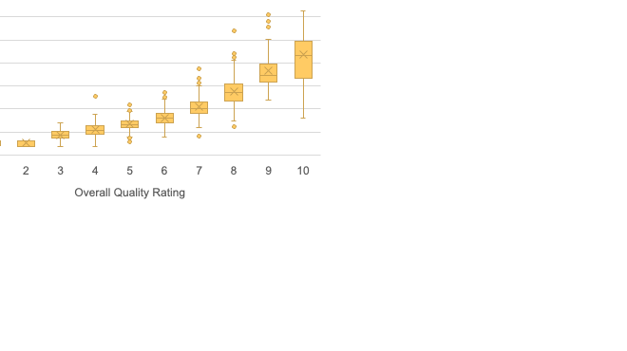
Overall Quality
Hypothesis: There is no significant difference in home price based on Overall Quality
Reject Null Hypothesis:
My findings confirmed the alternative hypothesis, indicating that the overall quality has an impact on average sales prices
Tested Variables: 7 & 4
The null hypothesis is rejected because the extremely small p-values, both for one-tailed and two-tailed tests, and the substantially higher t-statistic compared to the critical values provide strong evidence that there is a significant difference in the means of the two groups being compared.
Target homes with quality rating of 8+

Slide 10
Neighborhood
Hypothesis: There is no significant difference in home price based on Neighborhood
Reject Null Hypothesis:
My findings confirmed the alternative hypothesis, indicating that the choice of neighborhood has a significant impact on average sales prices.
Tested Variables: NridgHt & Sawyer
The t-statistic is very large, the p-values are extremely close to 0, and the confidence interval for the difference in means does not include zero.
The Top 10 Neighborhoods by Sale Price include:
NoRidge, NridgeHt, StoneBr, Timber, Veenker,
Somerst, ClearCr, Crawfor, CollgCr, Blmngtn

Slide 11
Garage Cars
Hypothesis: There is no significant difference in home price based on Garage Cars
Null Rejected:
My findings confirmed the alternative hypothesis, indicating the number of garage cars has a significant impact on average sales prices.
Tested Variables: 2 & 3
The t-test results strongly support the rejection of the null hypothesis. The t-statistic is large, the p-values are extremely close to 0, and the confidence interval for the difference in means does not include zero.
Homes with 3+ car garage has an average sales price of $309,636

Slide 12
Recommendations
When allocating funds for mortgage-backed securities investments, consider these factors:
1) Consider incorporating the presence of fireplaces as one of the factors influencing home prices. Properties with fireplaces tend to command higher prices. Therefore, an investment strategy that targets markets with a higher prevalence of fireplaces may lead to more favorable returns.
As shown above, homes with two or 3 fireplaces average higher sales prices.
2) Consider allocating a portion of the funds earmarked for mortgage-backed securities investments into markets with properties that exhibit higher overall quality, specifically homes with an overall quality rating of 8 or higher. This finding indicates that higher quality homes tend to command higher prices, making them potentially more stable and attractive investments. By focusing on markets with these higher-quality properties, you may enhance the potential returns on your investments in mortgage-backed securities.
3) Allocate funds for mortgage-backed securities investments with a focus on neighborhoods that demonstrate a significant difference in home prices. Specifically, consider investing in areas like "NridgHt" or "NoRidge where home prices are notably higher, as indicated by the findings. This targeted approach can potentially lead to more favorable returns on investments.
4) Allocate funds for mortgage-backed securities investments with consideration of the impact of the number of garage cars on home prices. The findings suggest that homes with a different number of garage cars command notably different prices. Therefore, targeting markets where this factor plays a significant role can potentially lead to more effective investment strategies.
As shown above, homes with 4+ car garage show decline in average sales prices.
Target homes with 3 car garage for the highest average sales prices.

